Slide 1
Screen Mockups (draft)
andy

Slide 2
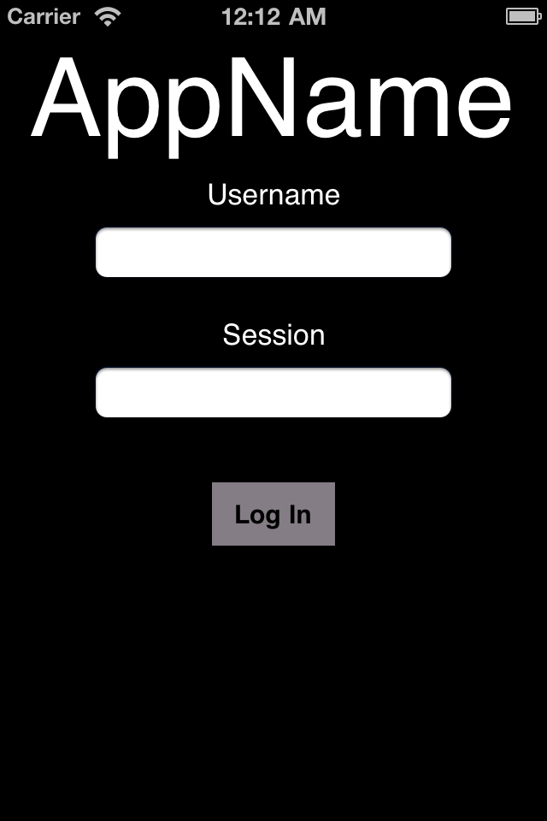
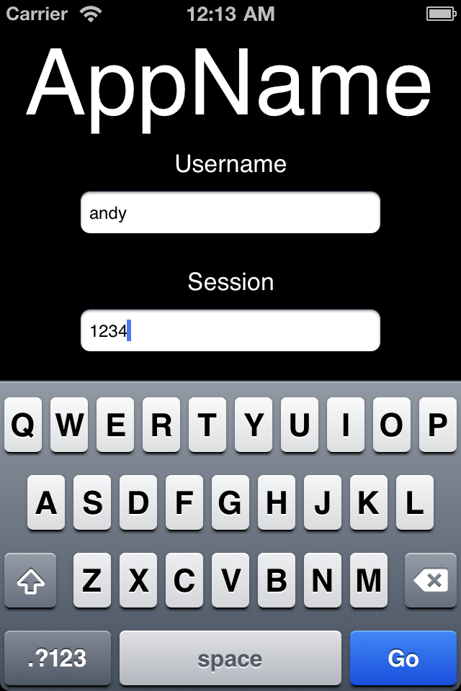
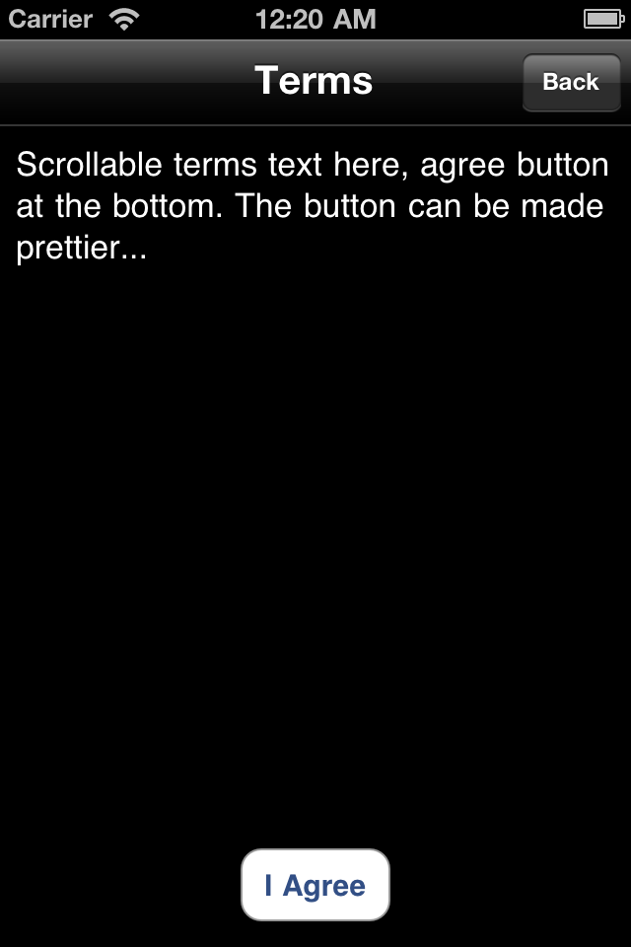

Slide 3
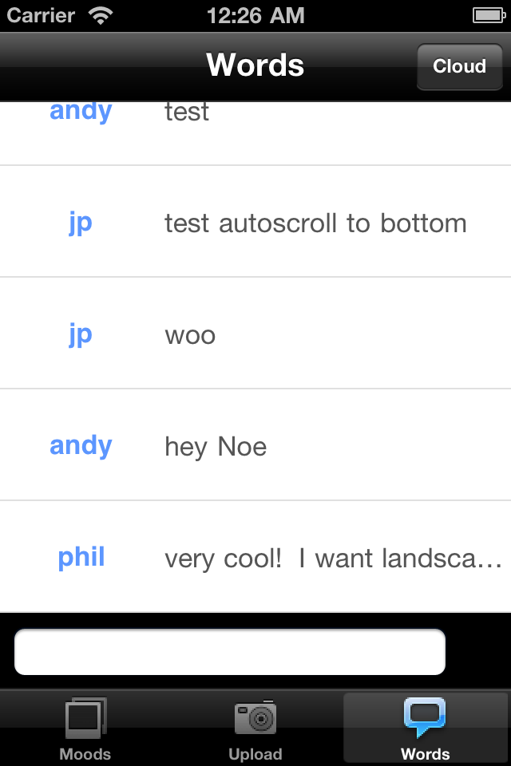
This is the screen where the user uploads the word/phrases
The tabs at the bottom will represent whatever other features we have. The other tabs right now come from Aurora so don’t mind them.
The user can tap on Cloud button on top right to access the cloud generated. This can be shown using a webview of the page.
When the user taps on the input textfield, a keyboard (black) appears, and the entire view (except the tab bar) shifts up to accommodate the keyboard.
There will be a “send” button to the right of the textfield.
User can see his/her own input history or the entire audience’s history on the table.

